Slide 1
Historic Year 2019-2023 and Forecast to 2032
EV Battery Market
Technology: Machine Learning, Natural Language Processing (Speech Recognition, Text Analytics) Application: Healthcare, Finance, Automotive By Region: North America, Europe, Asia-Pacific, Latin America, Middle East & Africa

Slide 2
MARKET SEGMENTATION
EV Battery Market (USD BILLION)
YEARS CONSIDERED :
Historical year - 2019-2023 | Base year - 2024 | Forecast year - 2025-2032
BY TECHNOLOGY
BY APPLICATION
Machine Learning
Natural Language Processing
Healthcare
Finance
Automotive

Slide 3








MARKET TAXONOMY
EV Battery Market (USD BILLION)
YEARS CONSIDERED :
Historical year - 2019-2023 | Base year - 2024 | Forecast year - 2025-2032
NORTH AMERICA
EUROPE
ASIA PACIFIC
LATIN AMERICA
MIDDLE EAST & AFRICA
Mexico
GCC Countries
United Kingdom
China
Brazil
Canada
Germany
France
Japan
Spain
South Korea
United States
Italy
India
South Africa
United Kingdom
Germany
France
Spain
GCC Countries
South Africa
Rest of MEA
Italy
Rest of Europe
China
Japan
India
Brazil
Mexico
Rest of LATAM
United States
Canada
South Korea
Rest of APAC

Slide 4
TABLE OF CONTENTS-
EV Battery Market -
Historic Year 2019-2023 and Forecast to 2032

Slide 5

TABLE OF CONTENTS
1. Introduction | 4.6.1. Competitive Rivalry
1.1. Objectives of the Study | 4.6.2. Threat of substitutes
1.2. Market Definition & Scope | 4.6.3. Bargaining power of buyers
2. Research Methodology | 4.6.4. Threat of new entrants
2.1. Research Process | 4.6.5. Bargaining power of suppliers
2.2. Secondary & Primary Data Methods | 5. Key Market Insights
2.3. Market Size Estimation Methods | 5.1. Key Success Factors
2.4. Market Assumptions & Limitations | 5.2. Market Impacting Factors
3. Executive Summary | 5.3. Top Investment Pockets
3.1. Global Market Outlook | 5.4. Market Attractiveness Index
3.2. Key Market Highlights | 5.5. Market Ecosystem
3.3. Segmental Overview | 5.6. PESTEL Analysis
3.4. Competition Overview | 5.7. Pricing Analysis
4. Market Dynamics & Outlook | 5.8. Regulatory Landscape
4.1. Macro-Economic Indicators​ | 5.9. Case Study Analysis
4.2. Drivers & Opportunitiess | 5.10. Value Chain Analysis
4.3. Restraints & Challenges | 5.11. KMI1
4.4. Supply Side Trends | 5.12. KMI2
4.5. Demand Side Trends | 6. EV Battery Market Size by Technology (2025-2032)
4.6. Porter's Analysis & Impact | 6.1. Machine Learning

Slide 6
TABLE OF CONTENTS
6.2. Natural Language Processing | 8.3.2. India
6.2.1. Speech Recognition | 8.3.3. Japan
6.2.2. Text Analytics | 8.3.4. South Korea
7. EV Battery Market Size by Application (2025-2032) | 8.3.5. Rest of Asia Pacific
7.1. Healthcare | 8.4. Latin America (By Technology, By Application)
7.2. Finance | 8.4.1. Brazil
7.3. Automotive | 8.4.2. Mexico
8. EV Battery Market Size by Region (2025-2032) | 8.4.3. Rest of Latin America
8.1. North America (By Technology, By Application) | 8.5. Middle East & Africa (By Technology, By Application)
8.1.1. US | 8.5.1. GCC Countries
8.1.2. Canada | 8.5.2. South Africa
8.2. Europe (By Technology, By Application) | 8.5.3. Rest of Middle East & Africa
8.2.1. UK | 9. Competitive Dashboard
8.2.2. Germany | 9.1. Top 5 Player Comparison
8.2.3. Spain | 9.2. Market Positioning of Key Players, 2024
8.2.4. France | 9.3. Strategies Adopted by Key Market Players
8.2.5. Italy | 9.4. Recent Developments in the Market
8.2.6. Rest of Europe | 9.5. Company Market Share Analysis, 2024
8.3. Asia-Pacific (By Technology, By Application) | 10. Key Company Profiles
8.3.1. China | 10.1. Tesla Inc.

Slide 7
10.1.1. Company Overview
10.1.2. Product Portfolio Overview
10.1.3. Financial Overview
10.1.4. Key Developments
The following companies are listed for indicative purposes only. Similar information will be provided for each, with detailed financial data available exclusively for publicly listed companies.
10.2. Panasonic Corporation
10.3. BYD Co Ltd.
10.4. LG Chem
10.5. Samsung SDI
10.6. CATL
10.7. A123 Systems LLC
10.8. EnerSys
10.9. GS Yuasa Corporation
10.10. Amperex Technology Limited
11. Conclusion & Recommendation
TABLE OF CONTENTS

Slide 8
TABLE OF CONTENTS

Slide 9
RESEARCH METHODOLOGY
EV Battery Market -
Historic Year 2019-2023 and Forecast to 2032

Slide 10
RESEARCH METHODOLOGY
Research Objective
The process begins with clearly defining the research objective, which serves as the foundation for the study. This step identifies the specific goals, questions, or problems the research aims to address.
Research Objective
Secondary Research
Secondary research involves collecting existing data from credible sources to build a comprehensive baseline. This stage gathers relevant insights to contextualize the study and identify data gaps.
Data Modelling
Secondary Research
Data Analysis
Primary Research
Primary Research
Primary research directly gathers first-hand data to validate, complement, or update insights obtained during secondary research. It involves interacting with industry stakeholders to provide real-time insights and market perspectives.
Data Modelling
This step involves using data modeling techniques to forecast future trends and market behavior. Predictive modeling ensures informed decision-making by aligning results with economic, industry, and population metrics.
Data Analysis
Data collected through secondary and primary research is rigorously analyzed to uncover patterns, trends, and actionable insights. This step ensures that findings are relevant, consistent, and aligned with the research objectives
Data Reporting
The findings and insights are compiled into a detailed, well-structured report that aligns with the client's needs and objectives. The report provides actionable recommendations and data-driven conclusions.
Data Reporting

Slide 11

SECONDARY RESEARCH
The purpose of secondary research is to build a solid foundation for understanding the target market by leveraging existing data, reports, and publications. This step is essential to gaining an initial perspective on the market size, trends, competitive dynamics, challenges, and opportunities. Secondary research helps map out broad market insights that can guide further exploration and refinement of the research focus.
Analyst's Role:
Source information from industry reports, government data, trade publications, and online repositories.
Map out the competitive landscape, market challenges, and emerging opportunities.
Highlight data gaps and refine the focus for primary research.
Data Sources
Association and Organization | Research Paper and Journal | Competition Data | Paid Databases | SkyQuest Internal Database
Battery Association of Japan | Journal of Power Sources | Annual Report | Factiva
International Battery Association | Journal of Energy Storage | Investor Presentation | Bloomberg
European Battery Alliance | Batteries | SEC Filling/ 10K Sizes | Hoovers
U.S. Department of Energy - Vehicle Technologies Office | Journal of Applied Electrochemistry | Company Website | Morningstar
International Energy Agency (IEA) | Energy Storage Materials | Trade Data | Seeking Alpha

Slide 12
PRIMARY RESEARCH
The purpose of executing primary research is to gather firsthand insights that validate and complement the data gathered during secondary research. By directly engaging with market participants, primary research ensures that the findings are grounded in real-world market dynamics. This step provides fresh, up-to-date, and specific information that is essential to gain a more nuanced understanding of the market, uncovering insights that secondary sources may not capture.
Analyst's Role:
Develop interview guides and surveys tailored to the study's objectives
Engage with key industry stakeholders, such as business leaders, end-users, and experts.
Capture a blend of qualitative and quantitative data, ensuring diversity in perspectives.
Break up of Primary Interviews with Industry Experts
BY COMPANY
BY DESIGNATION
BY REGION

Slide 13
EXECUTIVE SUMMARY
EV Battery Market -
Historic Year 2019-2023 and Forecast to 2032

Slide 14

EXECUTIVE SUMMARY
MARKET OUTLOOK
FIGURE 01. EV Battery Market , USD Billion
The global Electric Vehicle (EV) Battery Market is expected to witness substantial growth from 2019 to 2032. The market, valued at several billions of USD in 2019, is predicted to grow at a Compound Annual Growth Rate (CAGR) of robust percentage over the forecast period. This growth is fueled by the increasing adoption of electric vehicles worldwide, government incentives for EVs, and advancements in battery technology. The market share is divided among various key players, with potential for new entrants to contribute to the competitive landscape. The anticipated revenue increase can be attributed to the rising consumer focus on sustainable energy solutions, including electric transportation. This rapid expansion and the promising market scenario are attracting investments and innovation, further propelling the global EV Battery Market.
Key Market Enablers
500.4
Rising Adoption of Electric Vehicles: The increasing global awareness of climate change, the pressure on countries to lower their greenhouse gas emissions, along with supportive government policies are driving the adoption of electric vehicles (EVs). This surge in EV usage worldwide is leading to the expansion of the EV battery market. Governments are offering subsidies and tax benefits on purchasing EVs, and there's also a growing emphasis on setting up charging infrastructures globally. These factors collectively are playing a crucial role in promoting the use of EVs thus boosting the EV battery market. Technological Advancement and R&D in EV Batteries: Developments in technology and substantial investment in research and development (R&D) are paving the way for advancements in EV battery technology. Manufacturers are focusing on batteries that provide longer range, require shorter charging times, are cost-effective, and sustainable over a long period. Additionally, a shift towards solid-state batteries is expected to reshape the future of the EV battery market. Increased investment in R&D and rapid technological advancements have acted as major enablers for the growth of the EV battery market.
300.4

Slide 15
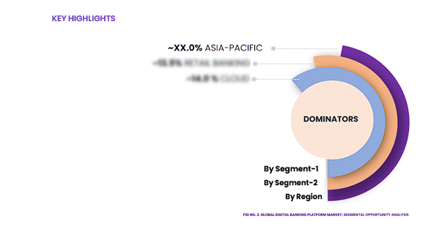
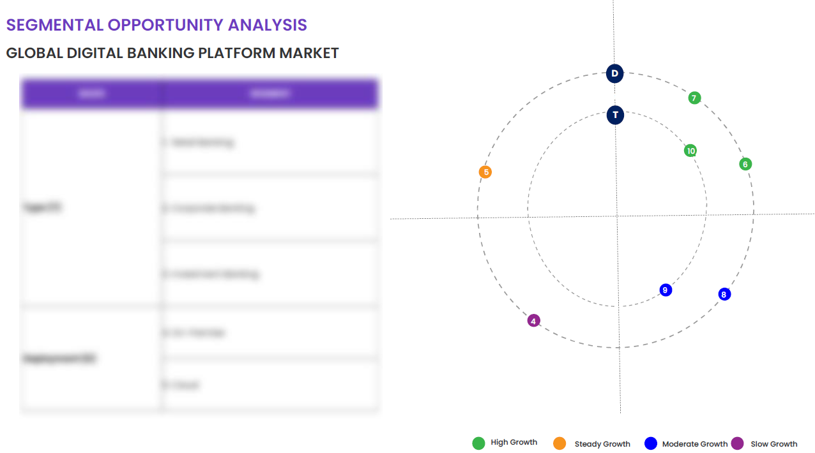
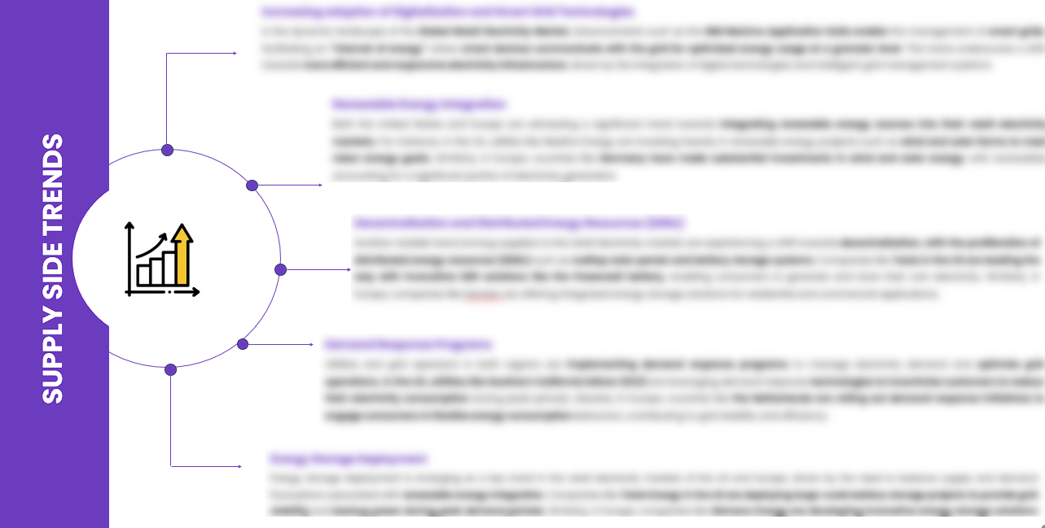
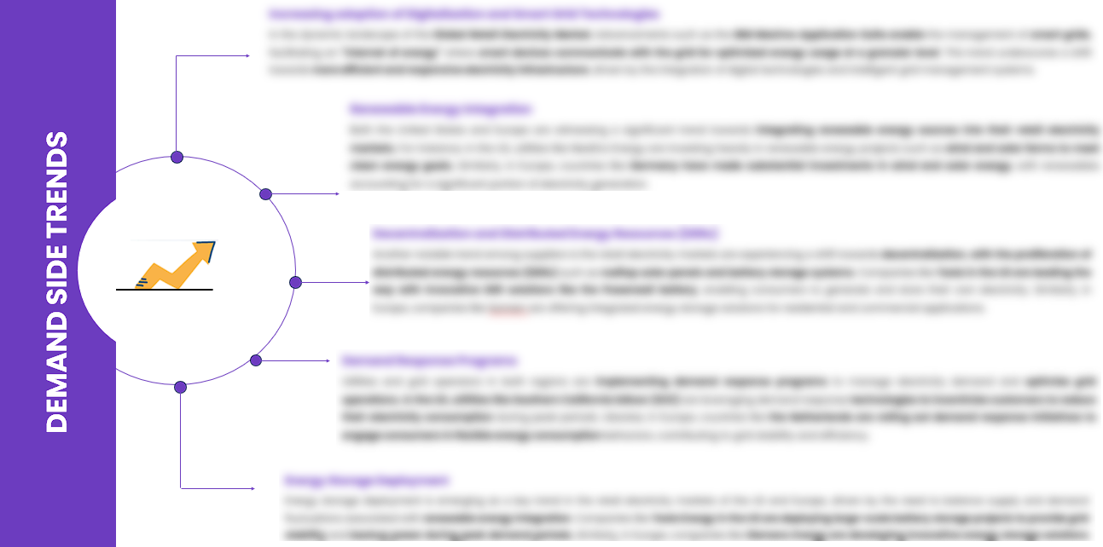
EXECUTIVE SUMMARY
SEGMENTAL OPPORTUNITY ANALYSIS
EV Battery Market
EV Battery Market ,2024
300.4 Billion
EV Battery Market ,2032
500.4 Billion
SUPPLY SIDE TRENDS
DEMAND SIDE TRENDS

Slide 16
MARKET OVERVIEW
Market Drivers & Challenges
Market Attractiveness - Porters Five Analysis
Threat of New Entrants
Bargaining Power of Suppliers
Bargaining Power of Buyers
Threat of Substitute
Intensity of Competitive Rivalry
EV Battery Market -
Historic Year 2019-2023 and Forecast to 2032

Slide 17

MARKET OVERVIEW: MARKET DRIVERS & OPPORTUNITIES
The Expanding Global Industry As A Key Driver For EV Battery Market
The global expansion of the technology industry plays a significant role in the growth of the Electric Vehicle (EV) battery market. As technology progresses, EV batteries have become more efficient, smaller in size, and longer-lasting, making electric vehicles a more appealing option for consumers globally. Simultaneously, technological advancements such as AI and predictive analysis are helping to optimize battery performance and lifespan, stimulating demand in the market. The technology sector is also a contributing factor for the development of the infrastructure required to support the EV market, primarily through the creation of advanced charging solutions. Innovations in fast charging technology significantly reduce charging time and improve the convenience of electric vehicles. Further, the evolving design and production of batteries through technology advancements raise the energy density, lowering the cost and making electric vehicles more accessible, further driving the EV battery market.

Slide 18

MARKET OVERVIEW: MARKET RESTRAINTS & CHALLENGES
High Initial Investment And Setup Costs Are Posing Challenge To The Growth Of The Market
The burgeoning market for Electric Vehicle (EV) batteries is facing a significant hurdle in terms of high initial investment and setup costs. The production of EV batteries necessitates sophisticated manufacturing facilities and a substantial investment in research and development, which can dissuade potential new entrants. These high costs also drive up the price of EV batteries, which can deter consumers and hamper market growth. The development of the infrastructure needed for large-scale EV battery production—from acquiring the raw materials to devising safe and efficient recycling processes—is a mammoth undertaking, requiring a tremendous amount of capital. Furthermore, EV batteries require a specific machine setup with associated machinery, maintenance and labour costs. The expensive nature of this setup is a challenge that needs addressing by the players in the EV battery market to drive substantial growth.

Slide 19




MARKET OVERVIEW

Slide 20
KEY MARKET INSIGHTS
Top Investment and White Space Opportunities
Market Ecosystem Mapping
Technological Advancements, Benefits, & Impacts
Market Attractiveness Index, 2024
PESTEL Analysis
Macro-Economic Indicators
Pricing Analysis
Regulatory Landscape
Key Success Factors
Market Impacting Factors
Patent Analysis
Raw Material Analysis
EV Battery Market -
Historic Year 2019-2023 and Forecast to 2032

Slide 21




KEY MARKET INSIGHTS

Slide 22
GLOBAL MARKET ANALYSIS, SEGMENTAL ANALYSIS
By Technology, By Application
EV Battery Market -
Historic Year 2019-2023 and Forecast to 2032

Slide 23

GLOBAL MARKET ANALYSIS – BY Technology
EV Battery Market SIZE, BY Technology, 2019-2023 (USD Billion)
Key Takeaways
 | 2019 | 2020 | 2021 | 2022 | 2023 | 2024 | 2025 | 2026 | 2027 | 2028 | 2029 | 2030 | 2031 | 2032 | CAGR (2025–2032)
Machine Learning | XX | XX | XX | XX | XX | XX | XX | XX | XX | XX | XX | XX | XX | XX | XX%
Natural Language Processing | XX | XX | XX | XX | XX | XX | XX | XX | XX | XX | XX | XX | XX | XX | XX%
Total | XX | XX | XX | XX | XX | XX | XX | XX | XX | XX | XX | XX | XX | XX | XX%
*Please note that this slide represents an indicative segmentation overview. the complete level-2 segmentation analysis will be covered in the Final Report.

Slide 24
GLOBAL MARKET ANALYSIS BY REGION
EV Battery Market -
Historic Year 2019-2023 and Forecast to 2032

Slide 25


GLOBAL MARKET ANALYSIS BY REGION
EV Battery Market : REGIONAL ANALYSIS, 2019-2023 (USD Billion)
Key Takeaways
Europe
North America secured the foremost market share at 30.4%, and this dominance is projected to persist through the forecast period. This stronghold is attributed to the region's dense concentration of market competitors and an upsurge in cancer incidence rates. Notably, the U.S. witnessed approximately 1,806,590 new cancer diagnoses in 2020, as reported by the National Cancer Institute. The continuous integration of novel technologies, incorporating artificial intelligence, and the frequent launch of low-radiation CT scans are anticipated to further contribute to the region's market growth.
Conversely, Asia Pacific is poised for noteworthy growth, projected to experience a substantial Compound Annual Growth Rate (CAGR) over the forecast period. This surge can be attributed to the ongoing development of healthcare infrastructure, particularly in burgeoning economies such as India and China. The region's high adoption rate of advanced medical imaging devices, coupled with the increasing prevalence of chronic disorders, further fuels market expansion. Notably, local manufacturers in the region are gaining prominence, bolstering market growth.
North America
APAC
MEA
Latin America
Region | 2019 | 2020 | 2021 | 2022 | 2023 | 2024 | 2025 | 2026 | 2027 | 2028 | 2029 | 2030 | 2031 | 2032 | CAGR (2025-2032)
North America | XX | XX | XX | XX | XX | XX | XX | XX | XX | XX | XX | XX | XX | XX | XX%
Europe | XX | XX | XX | XX | XX | XX | XX | XX | XX | XX | XX | XX | XX | XX | XX%
Asia-Pacific | XX | XX | XX | XX | XX | XX | XX | XX | XX | XX | XX | XX | XX | XX | XX%
Latin America | XX | XX | XX | XX | XX | XX | XX | XX | XX | XX | XX | XX | XX | XX | XX%
Middle East & Africa | XX | XX | XX | XX | XX | XX | XX | XX | XX | XX | XX | XX | XX | XX | XX%
Total | XX | XX | XX | XX | XX | XX | XX | XX | XX | XX | XX | XX | XX | XX | XX%

Slide 26
NORTH AMERICA MARKET ANALYSIS – BY Technology
NORTH AMERICA EV Battery Market SIZE, BY Technology, 2019-2023 (USD Billion)
 | 2019 | 2020 | 2021 | 2022 | 2023 | 2024 | 2025 | 2026 | 2027 | 2028 | 2029 | 2030 | 2031 | 2032 | CAGR (2025–2032)
Machine Learning | XX | XX | XX | XX | XX | XX | XX | XX | XX | XX | XX | XX | XX | XX | XX%
Natural Language Processing | XX | XX | XX | XX | XX | XX | XX | XX | XX | XX | XX | XX | XX | XX | XX%
Total | XX | XX | XX | XX | XX | XX | XX | XX | XX | XX | XX | XX | XX | XX | XX%
Key Takeaways
*Please note that this slide represents an indicative segmentation overview. the complete level-2 segmentation analysis will be covered in the Final Report.

Slide 27
U.S. MARKET ANALYSIS – BY Technology
U.S. EV Battery Market SIZE, BY Technology, 2019-2023 (USD Billion)
 | 2019 | 2020 | 2021 | 2022 | 2023 | 2024 | 2025 | 2026 | 2027 | 2028 | 2029 | 2030 | 2031 | 2032 | CAGR (2025–2032)
Machine Learning | XX | XX | XX | XX | XX | XX | XX | XX | XX | XX | XX | XX | XX | XX | XX%
Natural Language Processing | XX | XX | XX | XX | XX | XX | XX | XX | XX | XX | XX | XX | XX | XX | XX%
Total | XX | XX | XX | XX | XX | XX | XX | XX | XX | XX | XX | XX | XX | XX | XX%
Key Takeaways
*Please note that this slide represents an indicative segmentation overview. the complete level-2 segmentation analysis will be covered in the Final Report.

Slide 28
COMPETITIVE DASHBOARD Top 5 Players Comparison Market Positioning of Key Players, 2023 Strategies Adopted By Key Market Players Recent Development Market Share Analysis, 2023
EV Battery Market -
Historic Year 2019-2023 and Forecast to 2032

Slide 29




COMPETITIVE DASHBOARD
Why SkyQuest ?
Global 3D Printing Construction Market Competition Dashboard
The following figure represents the market positioning of EV Battery Market players for the year 2023. The market positioning of the leading player is done considering the following points:

Slide 30
COMPETITIVE DASHBOARD
COMPETITORS | Tesla Inc. | Company 2 | Company 3 | Company 4 | Company5
Headquarters | Palo Alto, California, United States | - | - | - | -
No of Employees | 71,000 (2020 estimate) | - | - | - | -
Revenue (US$) 2023 | 96.77 | - | - | - | -
Segmental Revenue (US$) 2024 | - | - | - | - | -
Product Overview | - | - | - | - | -
Geographic Presence | Global | - | - | - | -
Year of Establishment | July 1, 2003 | - | - | - | -
Market Position | - | - | - | - | -

Slide 31
COMPANY PROFILES
EV Battery Market -
Historic Year 2019-2023 and Forecast to 2032

Slide 32

Tesla Inc. - COMPANY OVERVIEW
COMPANY AT A GLANCE
Established | July 1, 2003
Headquarter | Palo Alto, California, United States
Ownership | Public
Revenue (US$)- 2024 | 115.23
Employees | 71,000 (2020 estimate)
Website | www.tesla.com
OVERVIEW
Tesla Inc., founded in 2003, is an American electric vehicle and clean energy company based in Palo Alto, California. Tesla is known for producing electric vehicles, but it also manufactures scalable clean energy generation and storage products. They have disrupted the automotive industry with the introduction of several luxury and mass-market electric car models, helping to accelerate the world's transition to sustainable energy. Known for high-performance electric cars, Tesla's vehicles are manufactured at various sites around the world. Its aim is to produce cars that do not compromise on speed, safety, or utility, demonstrating that an electric future is possible. Today, Tesla builds not only all-electric vehicles but also infinitely scalable clean energy generation and storage products. Their products work together to power homes and businesses with renewable energy, lowering running costs and increasing energy reliability.
PRODUCT OFFERING
PRODUCT NAME | DESCRIPTION
Tesla Model 3

Slide 33

Tesla Inc. - FINANCIAL OVERVIEW
Tesla Inc. - RECENT FINANCIALS IN USD BILLION (2022-2024) | Tesla Inc. - BUSINESS REVENUE MIX, 2024 IN PERCENTAGE (%)
SKYQUEST'S TAKE ON THE COMPANY

Slide 34

Tesla Inc. – KEY DEVELOPMENTS
DATE | TYPE OF DEVELOPMENT | DESCRIPTION
October 2023 | Partnership | Microsoft and Siemens are deepening their partnership by bringing the benefits of generative AI to industries worldwide. As a first step, the companies are introducing Siemens Industrial Copilot, an AI-powered jointly developed assistant aimed at improving human-machine collaboration in manufacturing. In addition, the launch of the integration between Siemens Teamcenter software for product lifecycle management and Microsoft Teams will further pave the way to enabling the industrial metaverse.
May 2023 | Product launch | Microsoft Corp. announced a suite of new AI solutions and improvements to Microsoft Clumping Clay for Nonprofit that are designed to transform the nonprofit industry and how fundraisers engage with donors, manage campaigns and optimize operations. In addition, the company announced a limited private preview for nonprofits to experience a new AI-powered fundraising propensity model.

Slide 35
ABOUT US & APPENDIX

Slide 36











ABOUT US
Established in 2006, SkyQuest is a Global Market Intelligence, Innovation Management organization that connects innovation to new markets, networks & collaborators for achieving sustainable development goals.
SOME OF OUR CLIENTS
180+ Institutional Clients 125000+ Streaming Clients 500+ Workshops Organized
Sectoral Coverage
| Information Technology | Clean Tech | Marketing & Advertising | Water | Life Sciences and Social | Social | Energy and Power | Food & Beverage | Training & E-Learnings & Materials | Semiconductor & Electronics | Oil & Gas | Banking, Financial, Capital Markets, Insurance

Slide 37
OUR CUSTOMIZED RESEARCH CAPABILITIES
CUSTOMER, DISTRIBUTOR, SUPPLIER INTELLIGENCE
TYPE INTELLIGENCE SUPPORT
Identification of potential partners
Shortlisting/finalization of potential partners
Customer need analysis
Customer's purchase and usage behavior
Customer/partner feedback and satisfaction
Brand perception analysis
Import and Export Intelligence
Commodity pricing intelligence
Product pricing intelligence
Product Positioning Assessment
New product launch tracker
Product claims assessment
Product Concept Testing
COMPETITIVE DASHBOARD SUPPORT
MARKET INTELLIGENCE SUPPORT
Company profiling
Competition assessment incl. market share
Drilled down revenue estimations
Employer value proposition
Market size and segmentation
Growth opportunities
Market dynamics and new developments
Go to Market Strategies
DATA COLLECTION AND ANALYSIS SUPPORT
MARKET STRUCTURE ASSESSMENT
Data analytics and visualization
Data collection, manipulation incl. web scraping
B2B and B2C surveys and interviews
Macroeconomic analysis
Value Chain and Communication Analysis
Regulatory assessment
Coating layer scouting and assessment

Slide 38
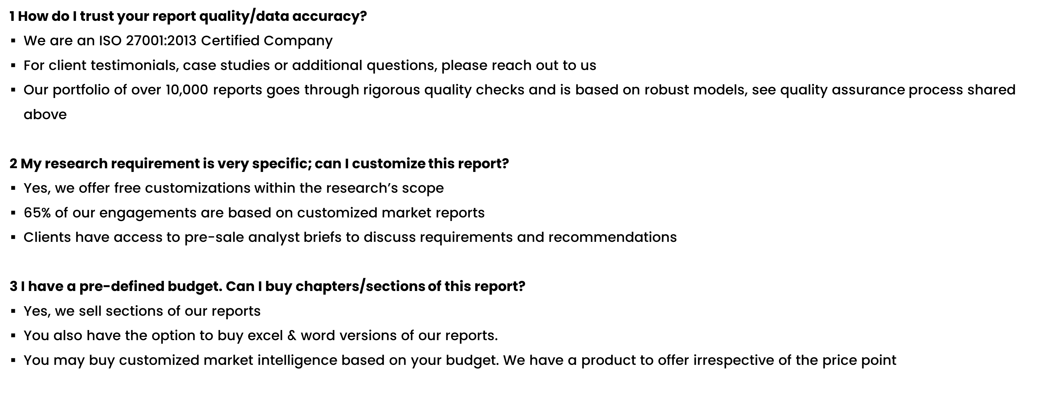
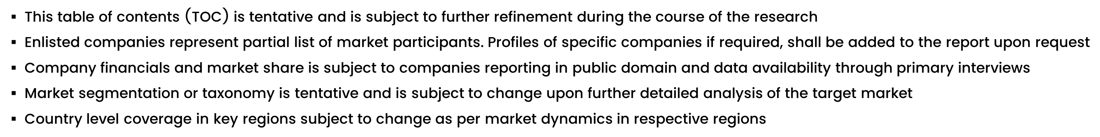
FAQs
NOTE

Slide 39






DISCLAIMER
SkyQuest provides strategic analysis to a select group of customers in response to orders. Our customers acknowledge when ordering that these strategic analysis for internal use and not for general publication or disclosure to any third party. SkyQuest does not endorse any vendor, product, or product type profiled in its publications. SkyQuest's strategic analysis constitutes estimations and projections based on secondary and primary research and are therefore subject to variations.
SkyQuest disclaims all warranties, expressed or implied, with respect to this research, including any warranties of merchantability or fitness, for any particular purpose. SkyQuest takes no responsibility for incorrect information supplied to it by manufacturers or users.
Trademarks, copyrights, and other forms of intellectual property belong to SkyQuest's respective owners and are protected by law. under no circumstance may any of these be reproduced, copied, or circulated in any form, without the prior written approval of SkyQuest's owner-as the case may be no part of this strategic analysis may be given, lent, resold, or disclosed to any third party, without express permission from SkyQuest team.
Reproduction and/or transmission in any form and by any means, including photocopying, mechanical, electronic, recording, or otherwise, without the permission of SkyQuest, is prohibited.
HEADQUARTERS
1 Apache Way, Westford, Massachusetts 01886, United States
APAC OFFICE
Room A & B, 2nd Floor, Lee Kee Commercial Building, 221-227, Queen’s Road Central, Hong Kong
GLOBAL DELIVERY CENTER
D-1001-1005, Swati Clover, Shilaj Circle, Sardar Patel Ring Rd, Thaltej, Ahmedabad, Gujrat-380054
WE ARE REACHABLE AT :-
info@skyquestt.com
+1-617-230-0741
www.skyquestt.com

Slide 40
THANK YOU
www.skyquestt.com

